Slide 1
Integrated Coastal Zone Management
Unit 2: Coastal Vulnerability

Slide 2
Introduction
Unit content
Identifying human impacts on the coast
Exploring coastal vulnerability
Relating human impacts to coastal vulnerability
Learning outcomes
Upon completion of this unit, students will be able to
Appreciate the range of human activities and their coastal impacts
Recognise the importance of magnitude and scale on coastal impacts
Understand the concept of coastal vulnerability
Understand how coastal activities affect coastal vulnerability

Slide 3
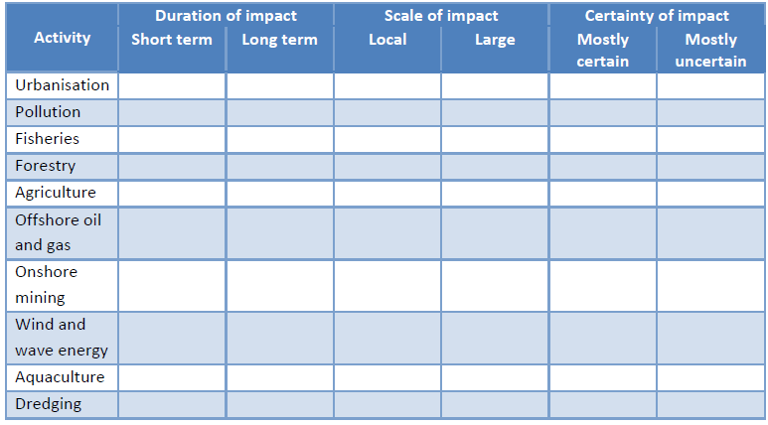
Human activities & impacts

Slide 4
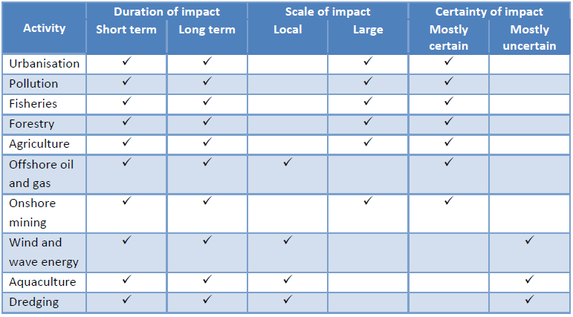
Human activities & impacts

Slide 5
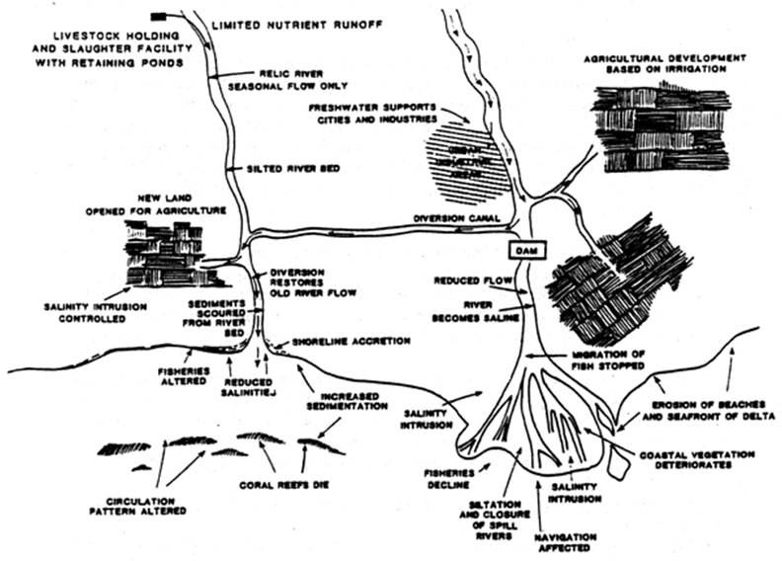
Direct and indirect impacts
Example: agriculture

Slide 6
Direct and indirect impacts
Agriculture
Direct impacts: eutrophication, pollution, salinisation
Indirect impacts: biodiversity loss, erosion, subsidence
Urbanisation
Direct impacts: eutrophication, pollution, habitat loss, turbidity, sediment movement
Indirect impacts: biodiversity loss, erosion
Climate change
Direct impacts: sea level rise, temperature rise, flooding, erosion, acidification
Indirect impacts: biodiversity loss, altered species abundance
Conclusion: loss of biodiversity is indirectly associated with all human activities

Slide 7
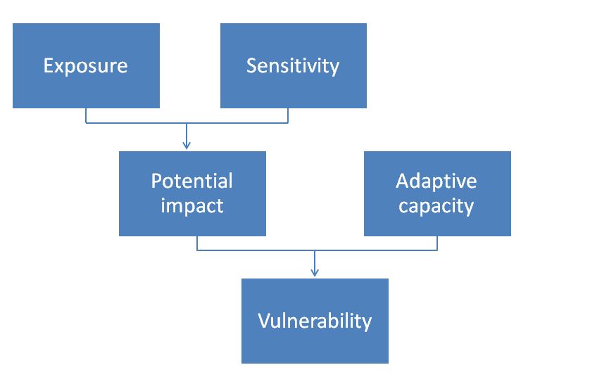
Coastal vulnerability

Slide 8
Coastal sensitivity
Sensitivity: probability of human impact affecting the environment (for example, biodiversity loss)
What aspects of the following ecosystems make them more or less sensitive to human impacts?
Coral reefs
Seagrass meadows
Mangroves

Slide 9
Managing threats
What are localised
threats to coral reefs?
Fishing
Agriculture
Forestry
Building development
Industrial activity
Tourism

Slide 10
Managing threats
What are localised
threats to coral reefs?
What are appropriate management options?
Fishing
Agriculture
Forestry
Building development
Industrial activity
Tourism
Increased regulation
Increased enforcement
Subsidising alternative activities
Promoting environmental awareness

Slide 11
Managing threats
What are localised
threats to coral reefs?
What are appropriate management options?
Fishing
Agriculture
Forestry
Building development
Industrial activity
Tourism
Increased regulation
Increased enforcement
Subsidising alternative activities
Promoting environmental awareness
Choice of management options = coastal management plan

